Slide 1
Spatial Filtering

Slide 2
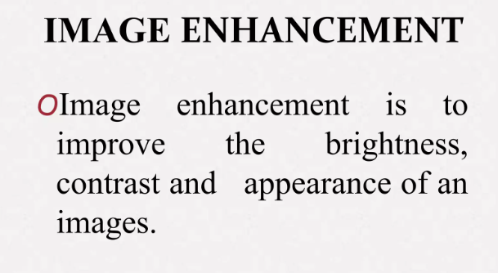

Slide 3
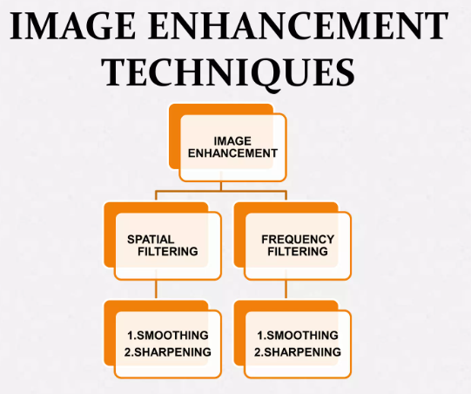

Slide 4
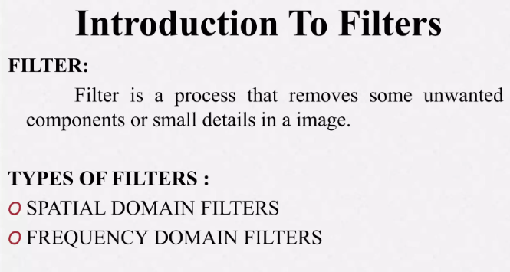

Slide 5
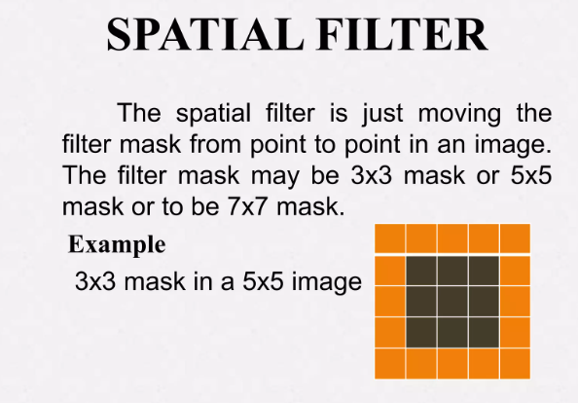

Slide 6
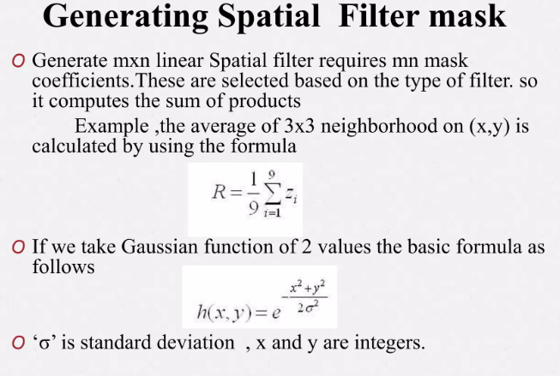

Slide 7
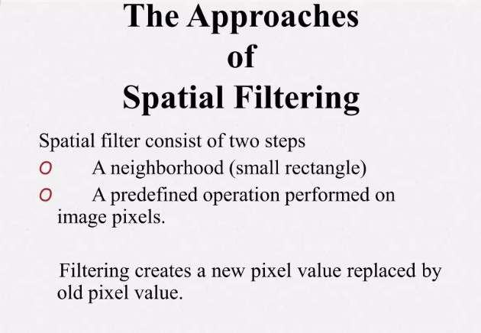

Slide 8
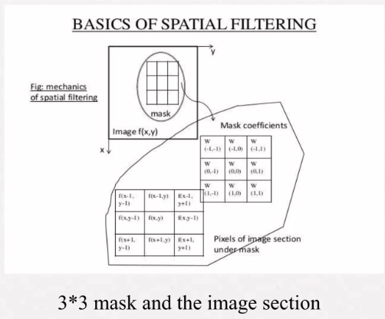

Slide 9
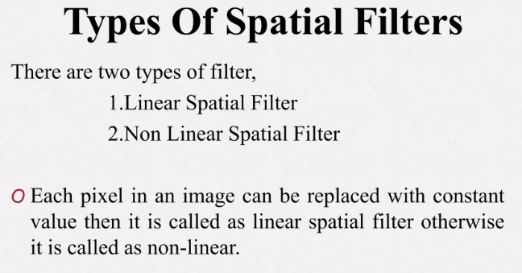

Slide 10
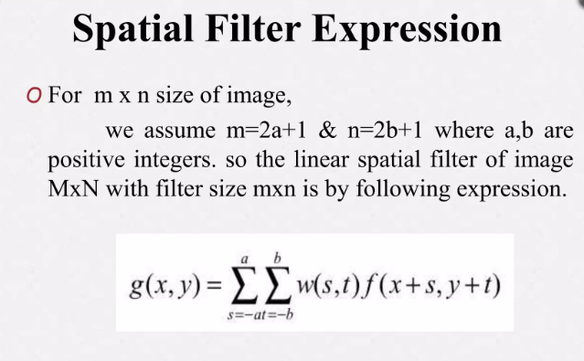

Slide 11
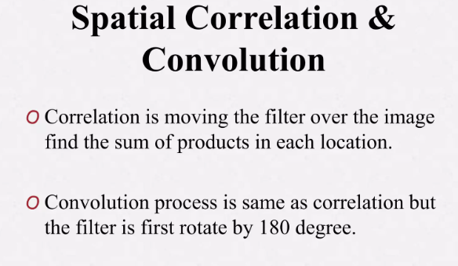

Slide 12
Numerical Correlation
Image: [100, 120, 100, 150, 160]
Mask: [1,0,-1]
Padded Image: [0, 100, 120, 100, 150, 160, 0]
Resultant Image: [-120, 0, -30, -60, 150]

Slide 13
Numerical Convolution
Image: [100, 120, 100, 150, 160]
Mask: [1,0,-1]
Padded Image: [0, 100, 120, 100, 150, 160, 0]
Flipped Mask: [-1, 0, 1]
Resultant Image: [120, 0, 30, 60, -150]

Slide 14
np.convolve()
np.correlate()

Slide 15
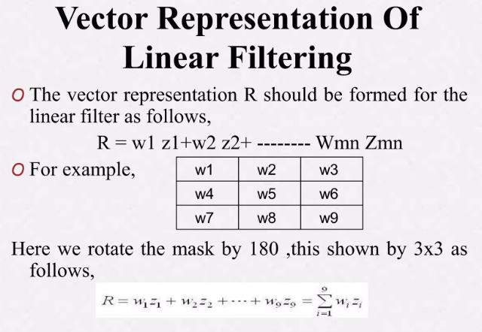

Slide 16
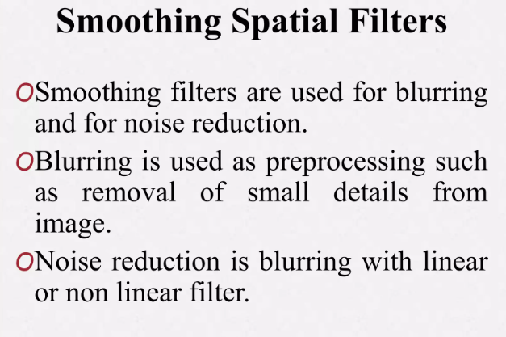

Slide 17
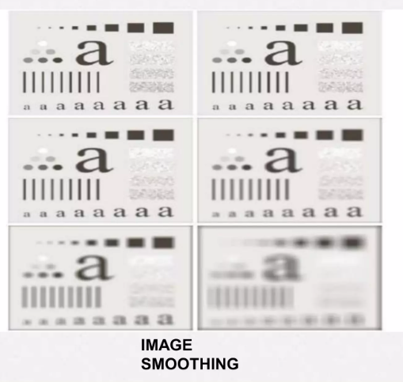

Slide 18
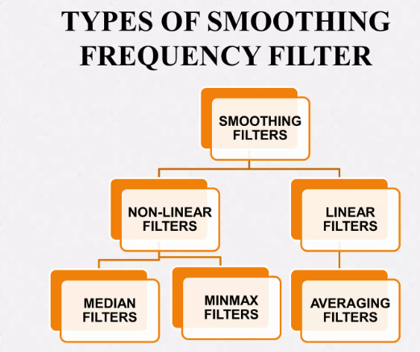

Slide 19
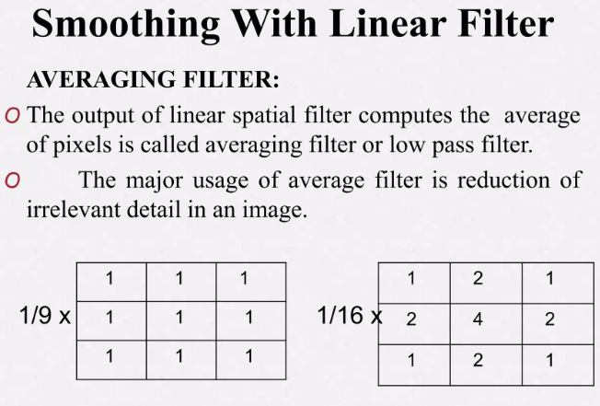

Slide 20
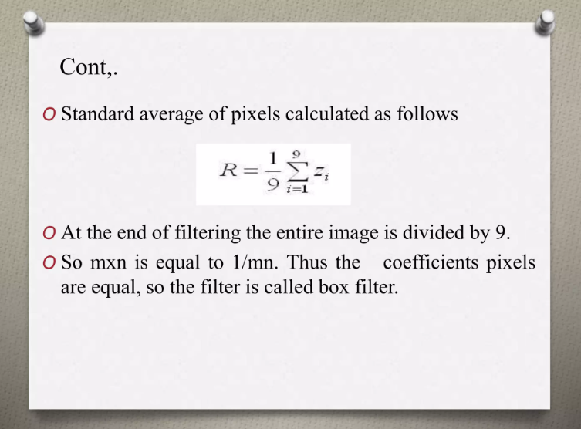

Slide 21
Program of Average Filter
import cv2
# Load an image
image = cv2.imread('image.jpg', cv2.IMREAD_GRAYSCALE)
# Apply the average filter
kernel_size = 5
filtered_image = cv2.blur(image, (kernel_size, kernel_size))
# Display the original and filtered images using matplotlib
plt.figure(figsize=(10, 6))
cv2.imshow(filtered_image)

Slide 22
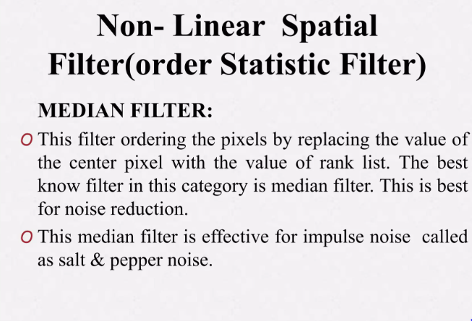

Slide 23
Program Median Blur
import cv2
# Load an image
image = cv2.imread('image.jpg', cv2.IMREAD_GRAYSCALE)
# Apply median blur
kernel_size = 5
blurred_image = cv2.medianBlur(image, kernel_size)
cv2.imshow(blurred_image, cmap='gray')

Slide 24
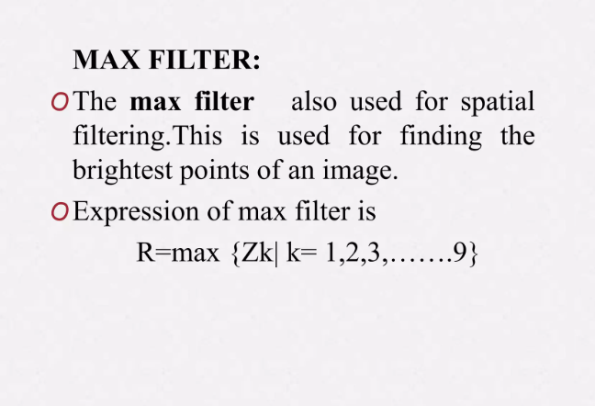

Slide 25
import cv2
# Load an image
image = cv2.imread('image.jpg', cv2.IMREAD_GRAYSCALE)
# Apply max filter
kernel_size = 5
kernel = np.ones((kernel_size, kernel_size), np.uint8)
max_filtered_image = cv2.dilate(image, kernel)
cv2.imshow(max_filtered_image, cmap='gray')

Slide 26
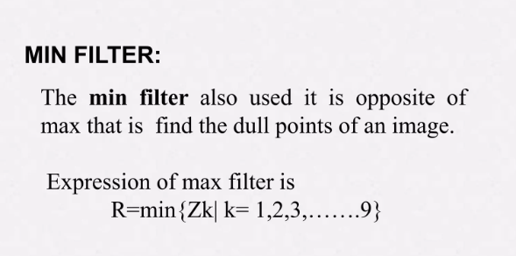

Slide 27
Program Min Filter
import cv2
# Load an image
image = cv2.imread('image.jpg', cv2.IMREAD_GRAYSCALE)
# Apply min filter
kernel_size = 5
kernel = np.ones((kernel_size, kernel_size), np.uint8)
min_filtered_image = cv2.erode(image, kernel)
plt.imshow(min_filtered_image, cmap='gray')

Slide 28
Average Blur
Principle: Average blur replaces each pixel's value with the average of its neighboring pixel values. It uses a simple convolution operation with a kernel of equal weights.
Effect: Average blur is effective at reducing high-frequency noise but can lead to blurring of edges and textures.
Edge Preservation: It does not preserve edges well, especially if the kernel size is large.
Use Cases: Basic noise reduction, where edge preservation is not a critical concern.

Slide 29
Median Blur
Principle: Median blur replaces each pixel's value with the median value of its neighboring pixel values. It is a non-linear filter.
Effect: Median blur effectively reduces salt-and-pepper noise while preserving edges and fine details.
Edge Preservation: It preserves edges well, making it suitable for images with impulsive noise.
Use Cases: Removing salt-and-pepper noise without significantly affecting image structure.

Slide 30
Gaussian Blur
Principle: Gaussian blur applies convolution with a Gaussian kernel. The Gaussian kernel is a weighted matrix with a bell-shaped distribution.
Effect: Gaussian blur effectively reduces noise while maintaining relatively smooth edges. It's suitable for general-purpose noise reduction.
Edge Preservation: It blurs edges to some extent, but less compared to average blur.
Use Cases: Noise reduction in images without strong edges.

Slide 31
Bilateral Blur
Principle: Bilateral blur combines spatial and color information. It considers both the spatial distance and color similarity between pixels when applying the blur.
Effect: Bilateral blur effectively reduces noise while preserving edges and fine textures.
Edge Preservation: It preserves edges very well, making it suitable for noise reduction without sacrificing image structure.
Use Cases: Noise reduction while preserving fine details, textures, and edges.

Slide 32
Gaussian Blur
import cv2
# Load an image
image = cv2.imread('image.jpg')
# Apply Gaussian blur
kernel_size = (5, 5) # Specify kernel size (width, height)
sigma_x = 0 # Standard deviation in X direction (if 0, it's computed from kernel size)
gaussian_blurred_image = cv2.GaussianBlur(image, kernel_size, sigmaX=sigma_x)
# Display the original and Gaussian-blurred images using matplotlib
plt.figure(figsize=(10, 6))
cv2.imshow(gaussian_blurred_image)

Slide 33
Bilateral Filter
import cv2
# Load an image
image = cv2.imread('image.jpg')
# Apply bilateral filter
diameter = 9 # Diameter of pixel neighborhood
sigma_color = 75 # Color standard deviation
sigma_space = 75 # Space standard deviation
bilateral_filtered_image = cv2.bilateralFilter(image, diameter, sigma_color, sigma_space)
# Display the original and bilateral-filtered images using matplotlib
plt.figure(figsize=(10, 6))
cv2.imshow(bilateral_filtered_image)

Slide 34
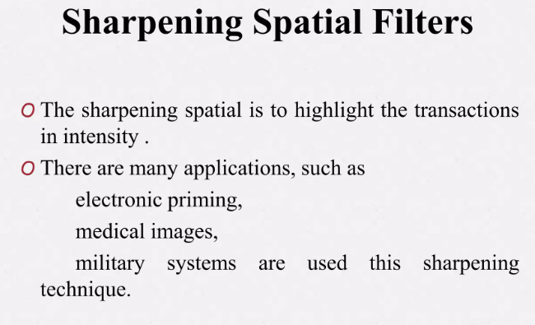

Slide 35
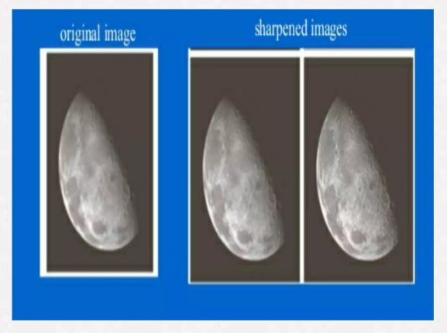

Slide 36
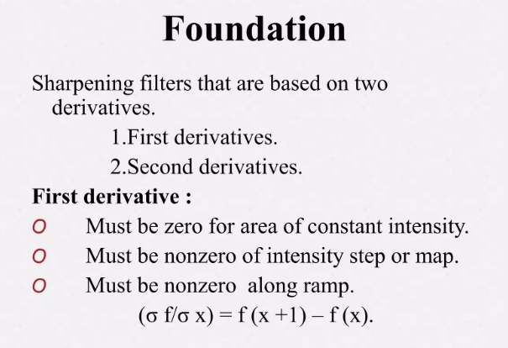

Slide 37
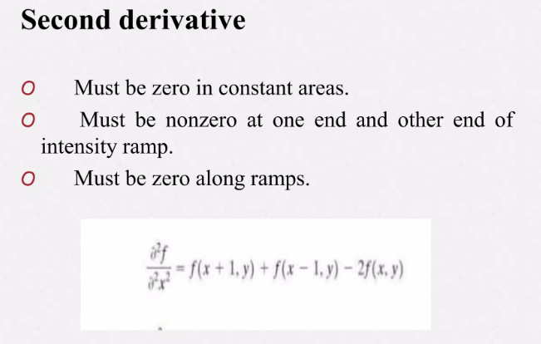

Slide 38
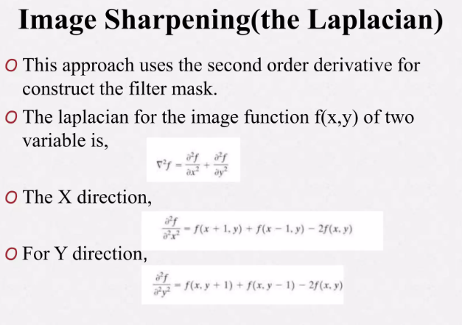

Slide 39
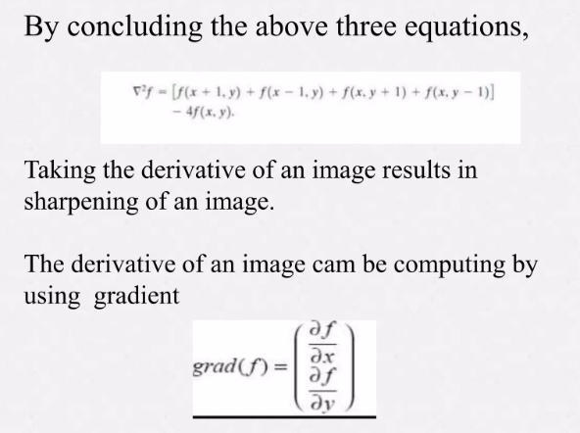

Slide 40
laplacian = cv2.Laplacian(image)

